Slide 1
Module 1

Slide 2

Outline of Module 1
Introduction
Data Warehousing
Multidimensional Data Model
OLAP Operations
Introduction to KDD process
Data mining
Data mining -On What kinds of Data
Data mining Functionalities
Classification of Data Mining Systems.

Slide 3
What is Data Warehouse?
Defined in many different ways
The process of centralizing an organization's historical data from various sources into a single, comprehensive database.
allows for advanced analytics, reporting, and informed decision-making across the enterprise.
Provides architectures and tools for business executives to systematically organize, understand, and use their data to make strategic decisions.
A data repository that is maintained separately from an organization’s operational database.
Notes:
An operational database, also known as an Online Transaction Processing (OLTP) system, is a type of database designed to manage and process high volumes of real-time transactions.

Slide 4
Outline of Module 1
Data Pre-processing
Data Cleaning
Data Integration and Transformation
Data Reduction
Data discretization
Concept hierarchy generation

Slide 5
What is Data Warehouse?
“A data warehouse is a subject-oriented, integrated, time-variant, and nonvolatile collection of data in support of management’s decision-making process.” - William H. Inmon
Data warehousing: The process of constructing and using data warehouses
Requires data cleaning, data integration, and data consolidation
Notes:
William H. Inmon (born 1945) is an American computer scientist, recognized by many as the father of the data warehouse.

Slide 6
Data Warehouse—Subject-Oriented
Organized around major subjects, such as customer, product, sales
Focusing on the modeling and analysis of data for decision makers, not on daily operations or transaction processing
Provide a simple and concise view around particular subject issues by excluding data that are not useful in the decision support process

Slide 7
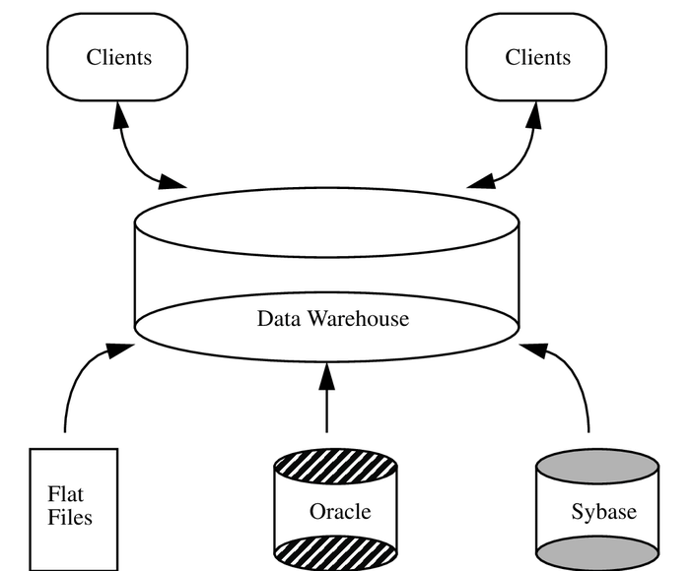
Data Warehouse—Integrated
Constructed by integrating multiple, heterogeneous data sources
relational databases, flat files, on-line transaction records
Data cleaning and data integration techniques are applied
Ensure consistency in naming conventions, encoding structures, attribute measures, etc. among different data sources
E.g., Hotel price: currency, tax, breakfast covered, etc.
When data is moved to the warehouse, it is converted.
Notes:
Flat files typically consist of plain text, meaning the data is stored in a human-readable format CSV files, A Shopping List, Web Log files

Slide 8
Data Warehouse—Time Variant
The time horizon for the data warehouse is significantly longer than that of operational systems
Operational database: current value data
Data warehouse data: provide information from a historical perspective (e.g., past 5-10 years)
Every key structure in the data warehouse
Contains an element of time, explicitly or implicitly
But the key of operational data may or may not contain “time element”

Slide 9
Data Warehouse—Nonvolatile
A physically separate store of data transformed from the application data found in the operational environment.
Operational update of data does not occur in the data warehouse environment
Does not require transaction processing, recovery, and concurrency control mechanisms
Requires only two operations in data accessing:
initial loading of data and access of data

Slide 10
How are organizations using the information from data warehouses?
To support business decision-making activities
(1) increasing customer focus
(2)Repositioning products and managing product portfolios by comparing the performance of sales
(3) analyzing operations and looking for sources of profit
(4) managing customer relationships,
making environmental corrections
managing the cost of corporate assets.
Notes:
To support business decision-making activities, including (1) increasing customer focus, which includes the analysis of customer buying patterns (such as buying preference, buying time, budget cycles, and appetites for spending); (2) repositioning products and managing product portfolios by comparing the performance of sales by quarter, by year, and by geographic regions in order to fine-tune production strategies; (3) analyzing operations and looking for sources of profit; and (4) managing customer relationships, making environmental corrections, and managing the cost of corporate assets.
Analyzing operations - Production/Service Delivery, Marketing & Sales, Customer Service, Financial Management
sources of profit - Revenue Growth, Cost Reduction, Improved Efficiency, Pricing Strategy

Slide 11
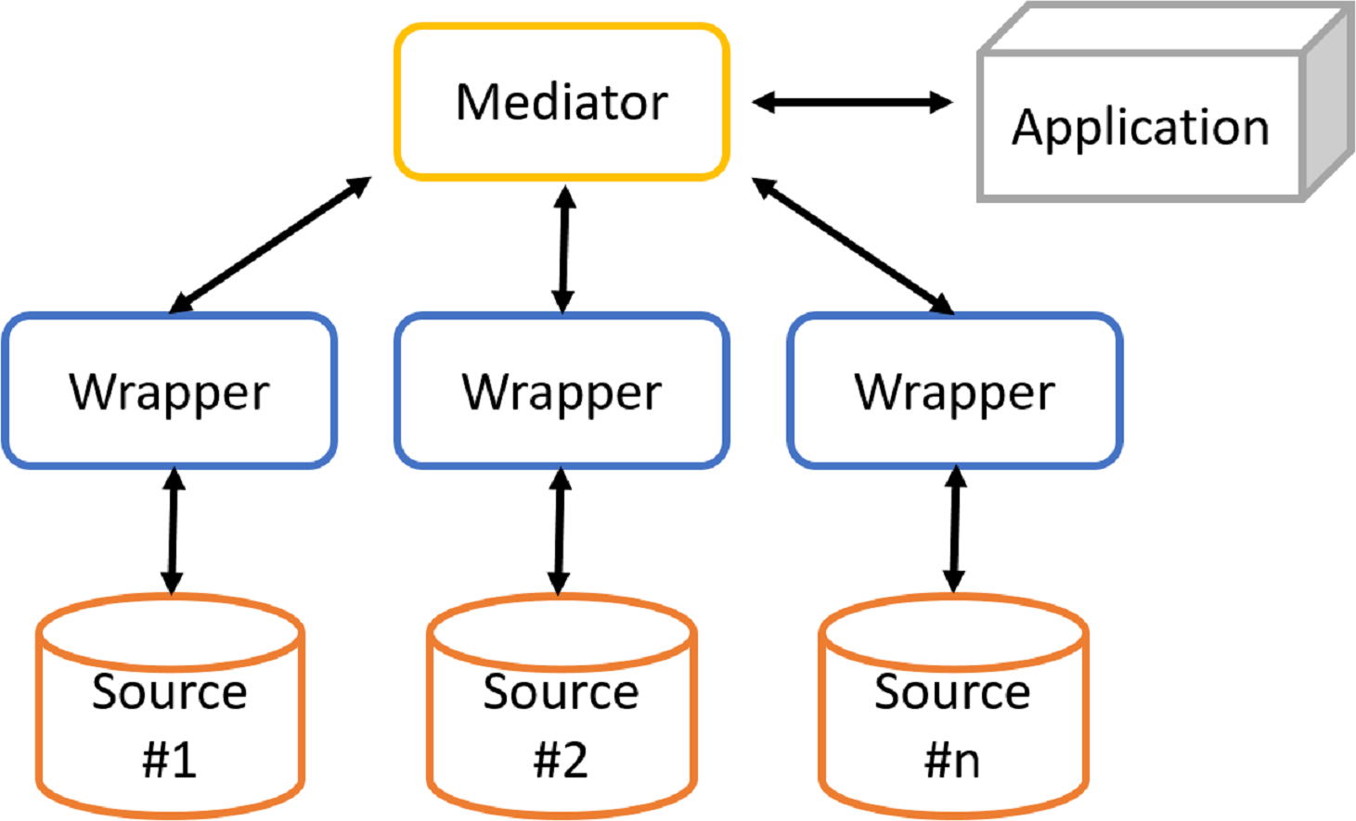
Data Warehouse vs. Heterogeneous DBMS
Traditional heterogeneous DB integration: A query driven approach
Build wrappers/mediators on top of heterogeneous databases
When a query is posed to a client site, a meta-dictionary is used to translate the query into queries appropriate for individual heterogeneous sites involved, and the results are integrated into a global answer set
Complex information filtering, compete for resources
It is inefficient and potentially expensive for frequent queries.

Slide 12
Data Warehouse vs. Heterogeneous DBMS
Data warehouse: update-driven, high performance
Information from heterogeneous sources is integrated in advance and stored in warehouses for direct query and analysis.
DW does not contain current information.
Reason for high performance of DW –
data are copied, preprocessed, integrated, annotated, summarized, and restructured into one semantic data store.
does not interfere with the processing at local sources.
can store and integrate historic information and support complex multidimensional queries.

Slide 13
Data Warehouse vs. Operational DBMS
OLTP (on-line transaction processing)
Major task of traditional relational DBMS
Day-to-day operations: purchasing, inventory, banking, manufacturing, payroll, registration, accounting, etc.
OLAP (on-line analytical processing)
Major task of data warehouse system
Data analysis and decision making
Distinct features (OLTP vs. OLAP):
User and system orientation: customer oriented vs. market-oriented
Data contents: current, detailed vs. historical, consolidated
Database design: ER + application oriented DB Design vs. star or snowflake + subject oriented DB Design
View: current, local vs. evolutionary nature of organization, data from various sources, various orgzns, huge volume , stored on multiple media
Access patterns: up-to-date data, short, atomic transactions vs. read-only but complex queries
Notes:
The major distinguishing features of OLTP and OLAP are summarized as follows:
Users and system orientation: An OLTP system is customer-oriented and is used for transaction and query processing by clerks, clients, and information technology professionals. An OLAP system is market-oriented and is used for data analysis by knowledge workers, including managers, executives, and analysts.
Data contents: An OLTP system manages current data that, typically, are too detailed to be easily used for decision making. An OLAP system manages large amounts of historic data, provides facilities for summarization and aggregation, and stores and manages information at different levels of granularity. These features make the data easier to use for informed decision making.
Database design: An OLTP system usually adopts an entity-relationship (ER) data model and an application-oriented database design. An OLAP system typically adopts either a star or a snowflake model and a subject-oriented database design.
View: An OLTP system focuses mainly on the current data within an enterprise or department, without referring to historic data or data in different organizations. In contrast, an OLAP system often spans multiple versions of a database schema, due to the evolutionary process of an organization. OLAP systems also deal with information that originates from different organizations, integrating information from many data stores. Because of their huge volume, OLAP data are stored on multiple storage media.
Access patterns: The access patterns of an OLTP system consist mainly of short, atomic transactions. Such a system requires concurrency control and recovery mechanisms. However, accesses to OLAP systems are mostly read-only operations (because most data warehouses store historic rather than up-to-date information), although many could be complex queries.

Slide 14
Module 1
Multidimensional Data Model

Slide 15
Multidimensional Data Model
Data warehouses and OLAP tools are based on a multidimensional data model.
This model views data in the form of a data cube.
“What is a data cube?”
A data cube allows data to be modeled and viewed in multiple dimensions.
It is defined by dimensions and facts.
In DW, the data cube is n-dimensional.

Slide 16
From Tables and Spreadsheets to Data Cubes
Dimensions are perspectives or entities with respect to which an organization wants to keep records. Eg. Sales with respect to time, item, branch, location.
Each dimension may have a table associated with it, called a dimension table, which further describes the dimension.
For example, a dimension table for item (may contain the attributes item name, brand, and type) or time (day, week, month, quarter, year)
Dimension tables can be specified by users or experts, or automatically generated and adjusted based on data distributions
Facts are numerical measures.
Fact table contains measures (such as dollars_sold, units_sold, amount_budgeted) and keys to each of the related dimension tables

Slide 17
From Tables and Spreadsheets to Data Cubes
A multidimensional data model is organized around a central theme, eg: sales.
Theme is represented by a fact table.
Facts are numeric measures.
Facts are quantities by which we analyze relationships between dimensions.
Examples: facts for a sales data warehouse include dollars_sold (sales amount in dollars),units_sold (number of units sold), and amount_budgeted.
The fact table contains the names of the facts, or measures, as well as keys to each of the related dimension tables.

Slide 18
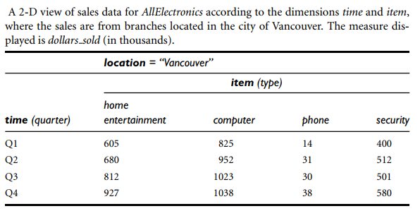

Slide 19
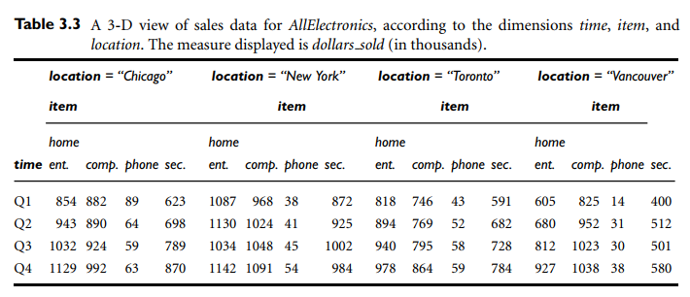

Slide 20
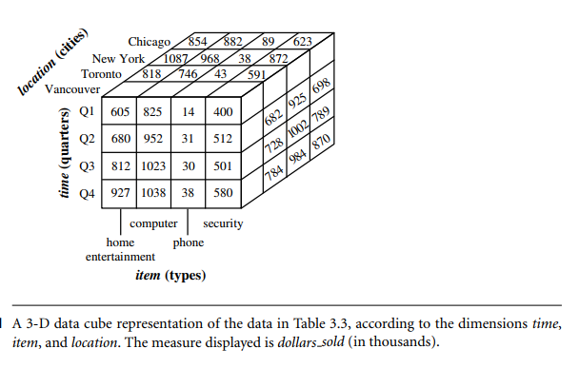

Slide 21
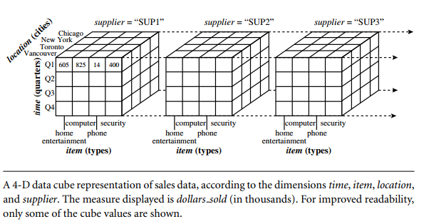

Slide 22
In data warehousing literature, a data cube is often referred to as a cuboid.
Given a set of dimensions, we can generate a cuboid for each of the possible subsets of the given dimensions.
The result would form a lattice of cuboids, each showing the data at a different level of summarization, or group-by.
The lattice of cuboids is then referred to as a data cube.
A base cuboid -The cuboid that holds the lowest level of summarization.
The 0-D cuboid, which holds the highest level of summarization, is called the apex cuboid.

Slide 23
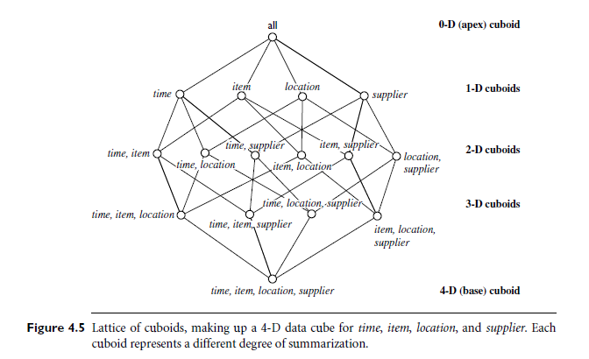
Lattice of Cuboids

Slide 24
Schemas for Multidimensional Databases
The ER model is used for relational database design. For data warehouse design we need a concise, subject-oriented schema that facilitates data analysis.
Multidimensional model exist in the form of :
Star schema: A fact table in the middle connected to a set of dimension tables
Snowflake schema: A refinement of star schema where some dimensional hierarchy is normalized into a set of smaller dimension tables, forming a shape similar to snowflake
Fact constellations: Multiple fact tables share dimension tables, viewed as a collection of stars, therefore called galaxy schema or fact constellation

Slide 25
Star schema
The most common modeling paradigm is the star schema.
The data warehouse contains
(1) a large central table (fact table) containing the bulk of the data, with no redundancy
(2) a set of smaller attendant tables (dimension tables), one for each dimension.
The schema graph resembles a starburst, with the dimension tables displayed in a radial pattern around the central fact table.
Limitation:
Each dimension is represented by only one table, and each table contains a set of attributes.
This constraint may introduce some redundancy.
For example, the location dimension table contains the attribute set {location key, street, city, province or state, country}. (Eg:Urbana, Chicago are cities in Illinois, USA).

Slide 26
Example of Star Schema
time
time_key
day
day_of_the_week
month
quarter
year
item
foreign keys
item_key
item_name
brand
type
supplier_type
Sales Fact Table
time_key
item_key
branch_key
branch
location
location_key
branch_key
branch_name
branch_type
location_key
street
city
province_or_street
country
units_sold
dollars_sold
avg_sales
Measures

Slide 27
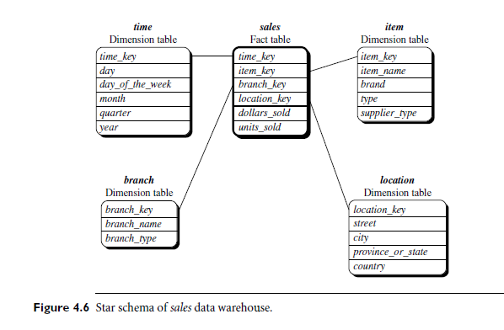

Slide 28

Snowflake schema
The snowflake schema is a variant of the star schema model.
Some dimension tables are normalized, thereby further splitting the data into additional tables.
The resulting schema graph forms a shape similar to a snowflake.
The dimension tables of the snowflake model may be kept in normalized form to reduce redundancies.
Tables - Easy to maintain and saves storage space.
However, this space savings is negligible.
Snowflake structure can reduce the effectiveness of browsing, since more joins will be needed to execute a query.
Consequently, the system performance may be adversely impacted.
Notes:
Snowflake schema: The snowflake schema is a variant of the star schema model, where some dimension tables are normalized, thereby further splitting the data into additional tables. The resulting schema graph forms a shape similar to a snowflake.
The major difference between the snowflake and star schema models is that the dimension tables of the snowflake model may be kept in normalized form to reduce redundancies. Such a table is easy to maintain and saves storage space. However, this space savings is negligible in comparison to the typical magnitude of the fact table. Furthermore, the snowflake structure can reduce the effectiveness of browsing, since more joins will be needed to execute a query. Consequently, the system performance may be adversely impacted. Hence, although the snowflake schema reduces redundancy, it is not as popular as the star schema in data warehouse design.

Slide 29
Example of Snowflake Schema
time
item
time_key
day
day_of_the_week
month
quarter
year
item_key
item_name
brand
type
supplier_key
supplier
Sales Fact Table
supplier_key
supplier_type
time_key
item_key
branch_key
branch
location
location_key
location_key
street
city_key
branch_key
branch_name
branch_type
units_sold
city
dollars_sold
city_key
city
province_or_street
country
avg_sales
Measures
normalization

Slide 30
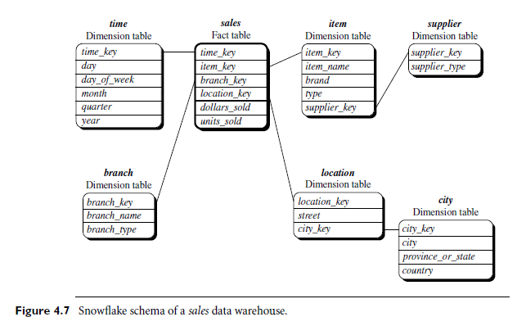

Slide 31
Fact constellation
Sophisticated applications.
Multiple fact tables to share dimension tables.
This kind of schema can be viewed as a collection of stars, and hence is called a galaxy schema or a fact constellation.
A fact constellation schema allows dimension tables to be shared between fact tables.

Slide 32
Example of Fact Constellation
time
time_key
day
day_of_the_week
month
quarter
year
item
Shipping Fact Table
item_key
item_name
brand
type
supplier_type
Sales Fact Table
time_key
time_key
item_key
shipper_key
item_key
branch_key
from_location
branch
location_key
location
to_location
branch_key
branch_name
branch_type
units_sold
location_key
street
city
province_or_street
country
dollars_cost
dollars_sold
units_shipped
avg_sales
shipper
Measures
shipper_key
shipper_name
location_key
shipper_type

Slide 33
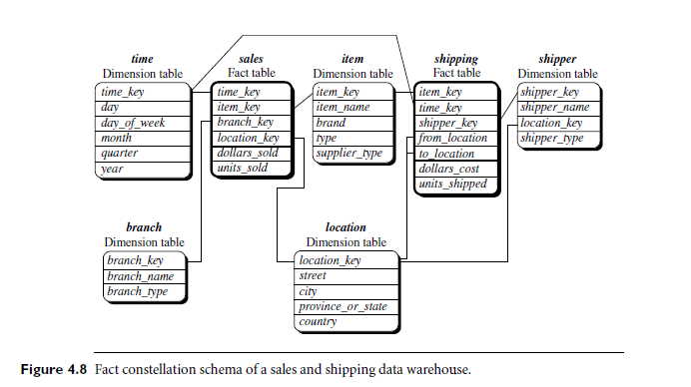

Slide 34
Data Warehouse and Data Mart
DATA WAREHOUSE
Collects information about subjects that span the entire organization, such as customers, items, sales, assets, and personnel
Its scope is enterprise-wide.
The fact constellation schema is commonly used, since it can model multiple, interrelated subjects.
DATA MART
A department subset of the data warehouse that focuses on selected subjects((e.g., sales, marketing, finance).
Its scope is departmentwide.
The star or snowflake schema is commonly used, since both are geared toward modeling single subjects, although the star schema is more popular and efficient.

